Slide 1
Lecture 2 Single-cell chromatin accessibility: Deciphering chromatin accessibility heterogeneity in cell populations
Physalia workshop 2021 — Bulk and single-cell ATAC-seq analysis
Instructor: Jacques Serizay

Slide 2
Single-cell approaches to profile chromatin accessibility
10X Genomics “easy” scATAC-seq:
Essentially performing ATAC-seq then barcoding within tiny droplets, each containing a single nucleus.
sci-ATAC-seq:
Randomly sorting cells in 384-well plates and indexing cells. Pool and repeat. After several rounds, each cell has a unique combination of indices. ATAC-seq is then performed on pooled cells and demultiplexing is done after sequencing.
“Manual” scATACseq using microfluidics:
https://www.10xgenomics.com/products/single-cell-atac
Amini et al., Nat. Genet. 2014 / Lareau et al., 2019
Amini et al., Nat. Genet. 2014

Slide 3
Multi-omics approaches to profile chromatin
10x Genomics Multiome:
Standard 10X chromium controller to encapsulate cells in droplets similar to the scATAC-seq kit. You need to extract nuclei and tagment them in bulk before loading them into the instrument.
sciCAR:
Plate-based combinatorial indexing strategy and essentially combines sciRNA-seq and sciATAC-seq.
scCAT-seq:
Lower-throughput plate-based method for dual gene expression DNA accessibility profiling.
SNARE-seq:
First droplet-based RNA/ATAC co-assay method, using tricks to collect both DNA and RNA information using standard Drop-seq beads
Cao et al. 2018
Liu et al. 2019
Chen, Lake, and Zhang 2019

Slide 4
Spatially resolved single cell ATAC-seq
sciMAP-ATAC:
Performing sci-ATAC-seq after manual microdissection of cryosections. Retains the positional information of each cell within a 214 micron cubic region, with up to hundreds of tracked positions in a single experiment
Spatial-ATAC-seq:
On-slide microfluidics-based barcoding of fixed thin organ slices (DBiT-seq).
Thornton et al., 2021
Deng et al., 2021

Slide 5
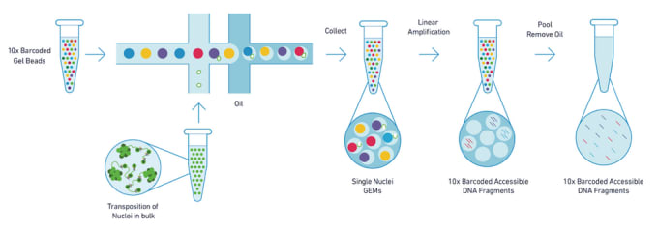
10X Genomics single-cell ATAC-seq tagmentation occurs in bulk
Once nuclei are isolated, tagmentation happens just like bulk ATAC-seq.
After tagmentation, intact nuclei are loaded with barcoded beads to make the sequencing library.

Slide 6
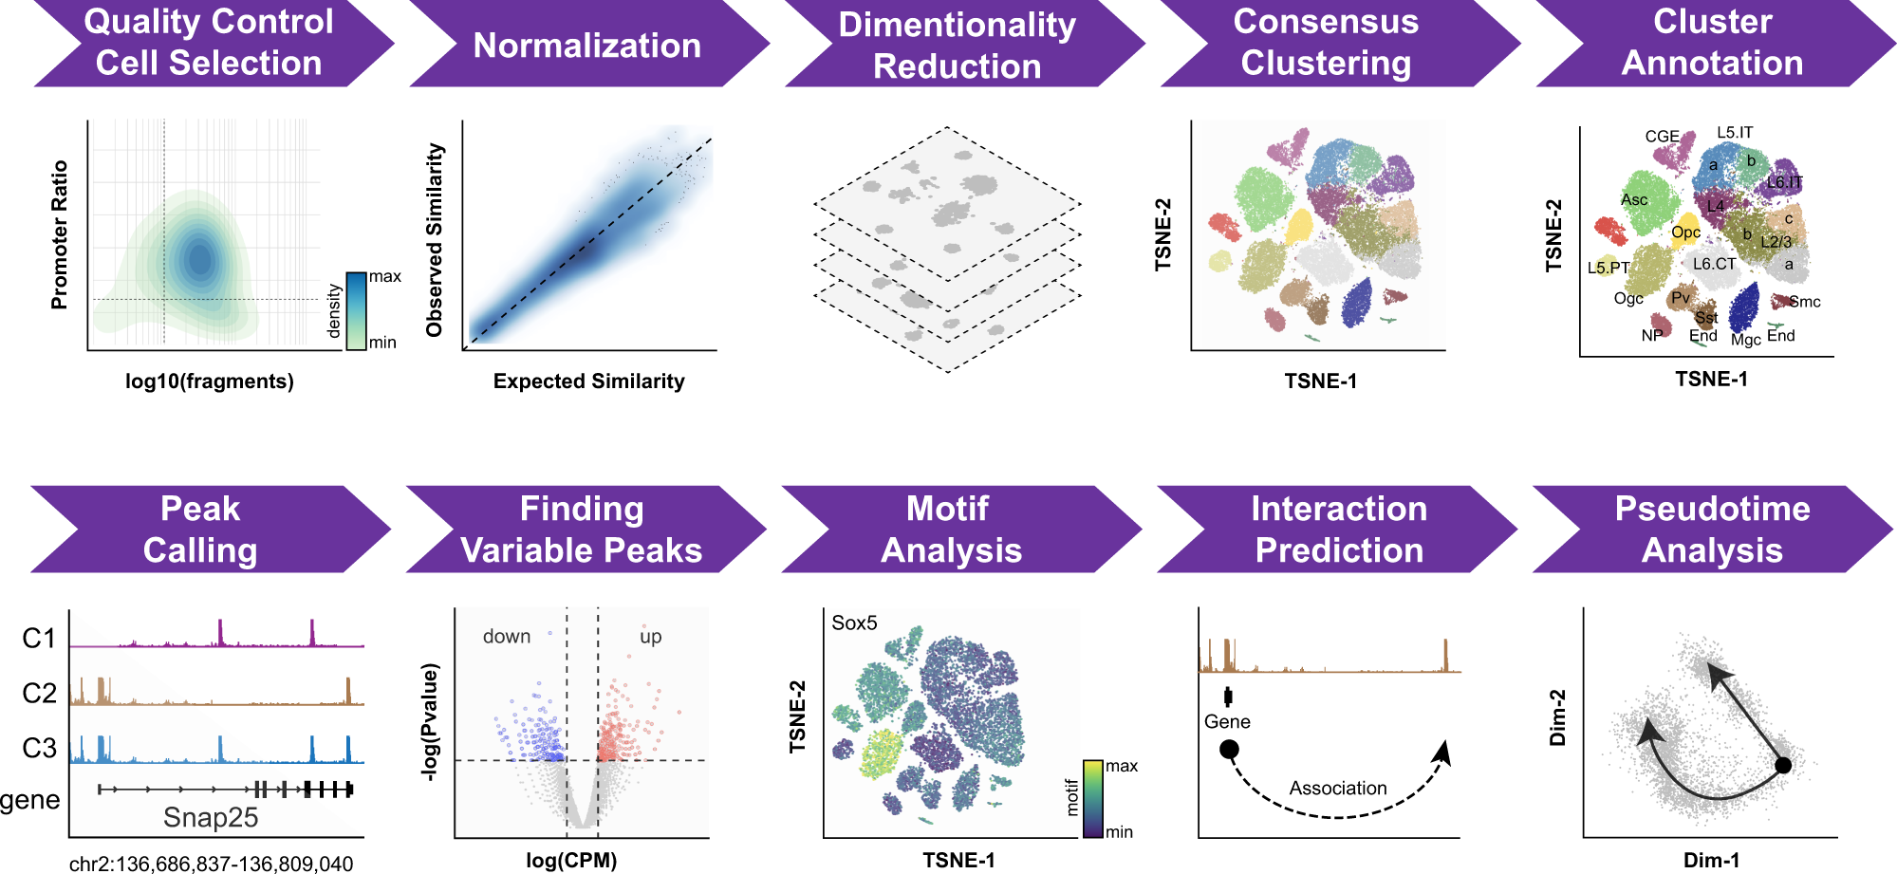
Single-cell ATAC-seq processing
scATACseq processing steps are different from scRNAseq, notably to the extreme sparsity of the data. The counts are often binarized, the normalization relies on Latent Semantic Indexing, and the dimensionality reductions use the SVD algorithm.
Fang et al., Nat. Comm. 2021

Slide 7
Single-cell ATAC-seq processing
However, clustering strategy is often same than scRNAseq, relying on graph-based community-finding algorithms.
Fang et al., Nat. Comm. 2021

Slide 8
Single-cell ATAC-seq QC and analysis are essentially the same than in bulk
Peak calling, DA analysis, motif analysis and interaction predictions are all steps which can be done with bulk ATAC-seq datasets.
Fang et al., Nat. Comm. 2021

Slide 9
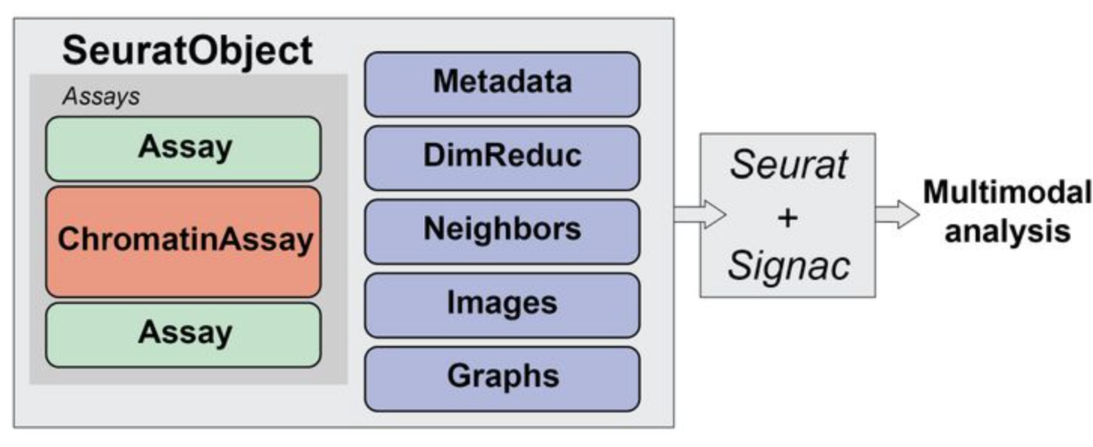
Signac: extending Seurat for chromatin accessibility single-cell assays
Signac builds on top of the `Seurat` objects.
Tim Stuart et al, 2021

Slide 10
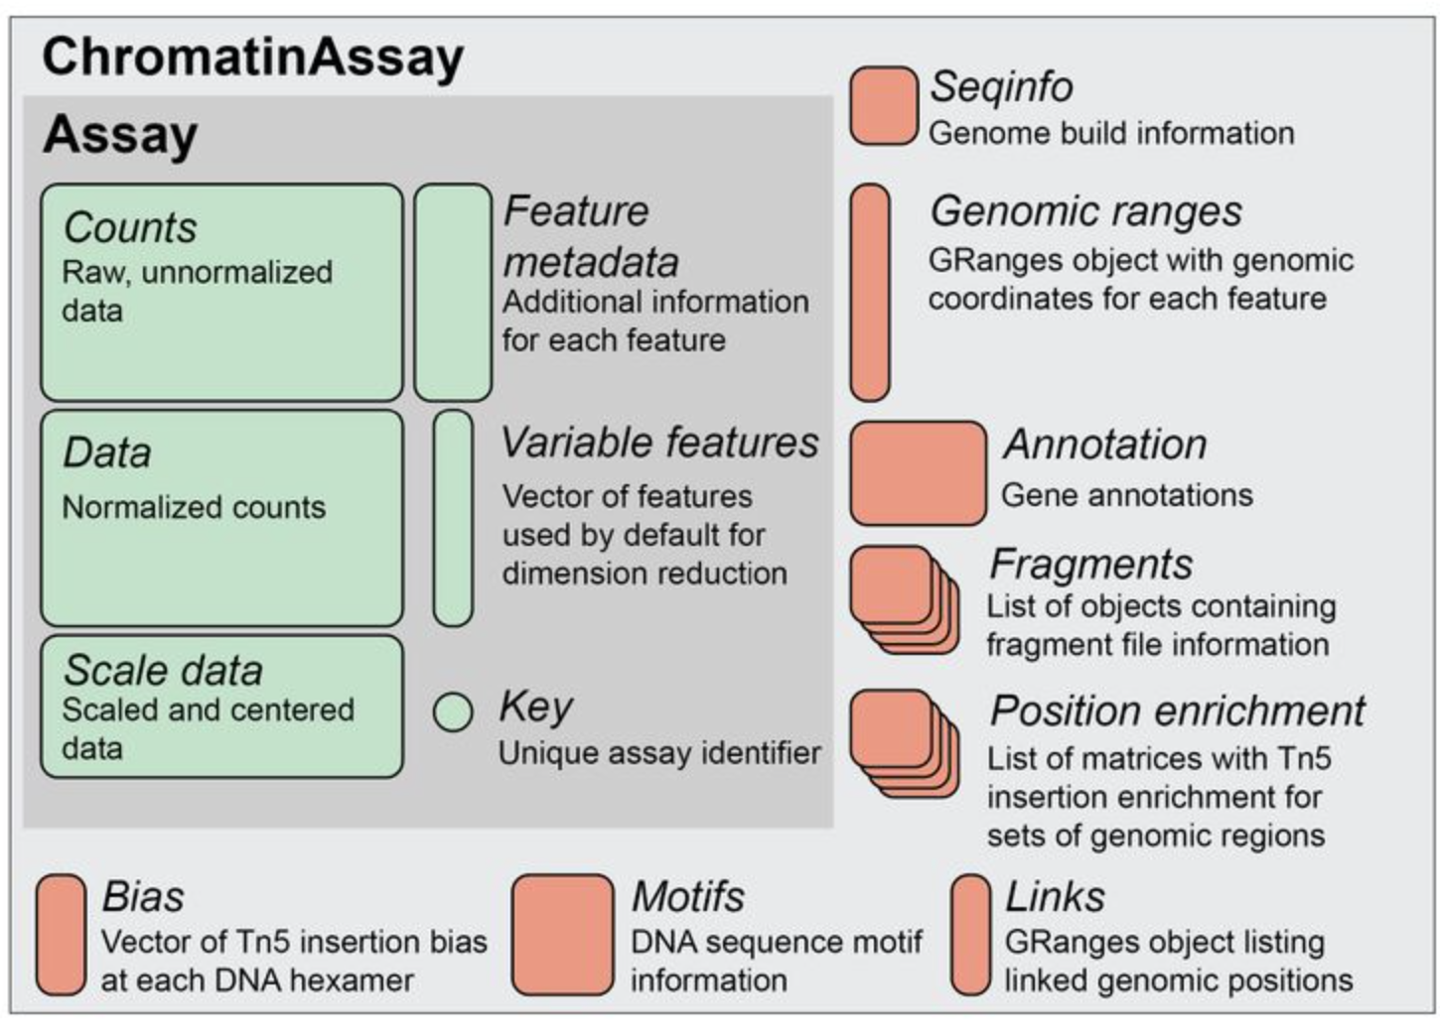
Signac: extending Seurat for chromatin accessibility single-cell assays
`ChromatinAssay` contains more information than canonical `Assay` objects from Seurat.
Tim Stuart et al, 2021

Slide 11
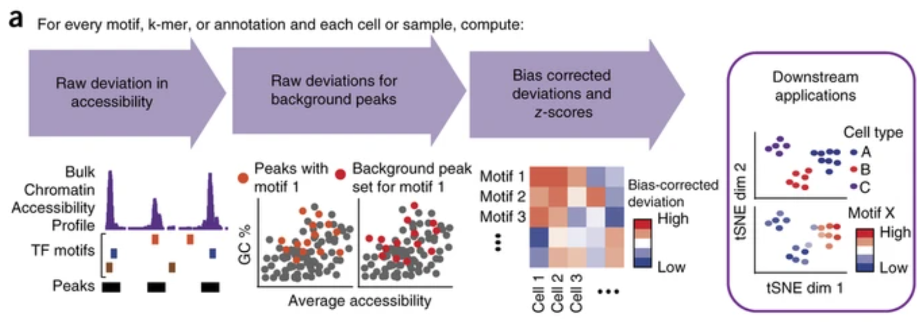
chromVAR can identify TF motif “activity”
Using single-cell ATAC-seq data, as well as motif databases, chromVAR can identify which TF motifs are enriched in each cell and provides a framework to re-cluster cells based on TF “activity”.
Schep et al., Nat. Methods 2017

Slide 12
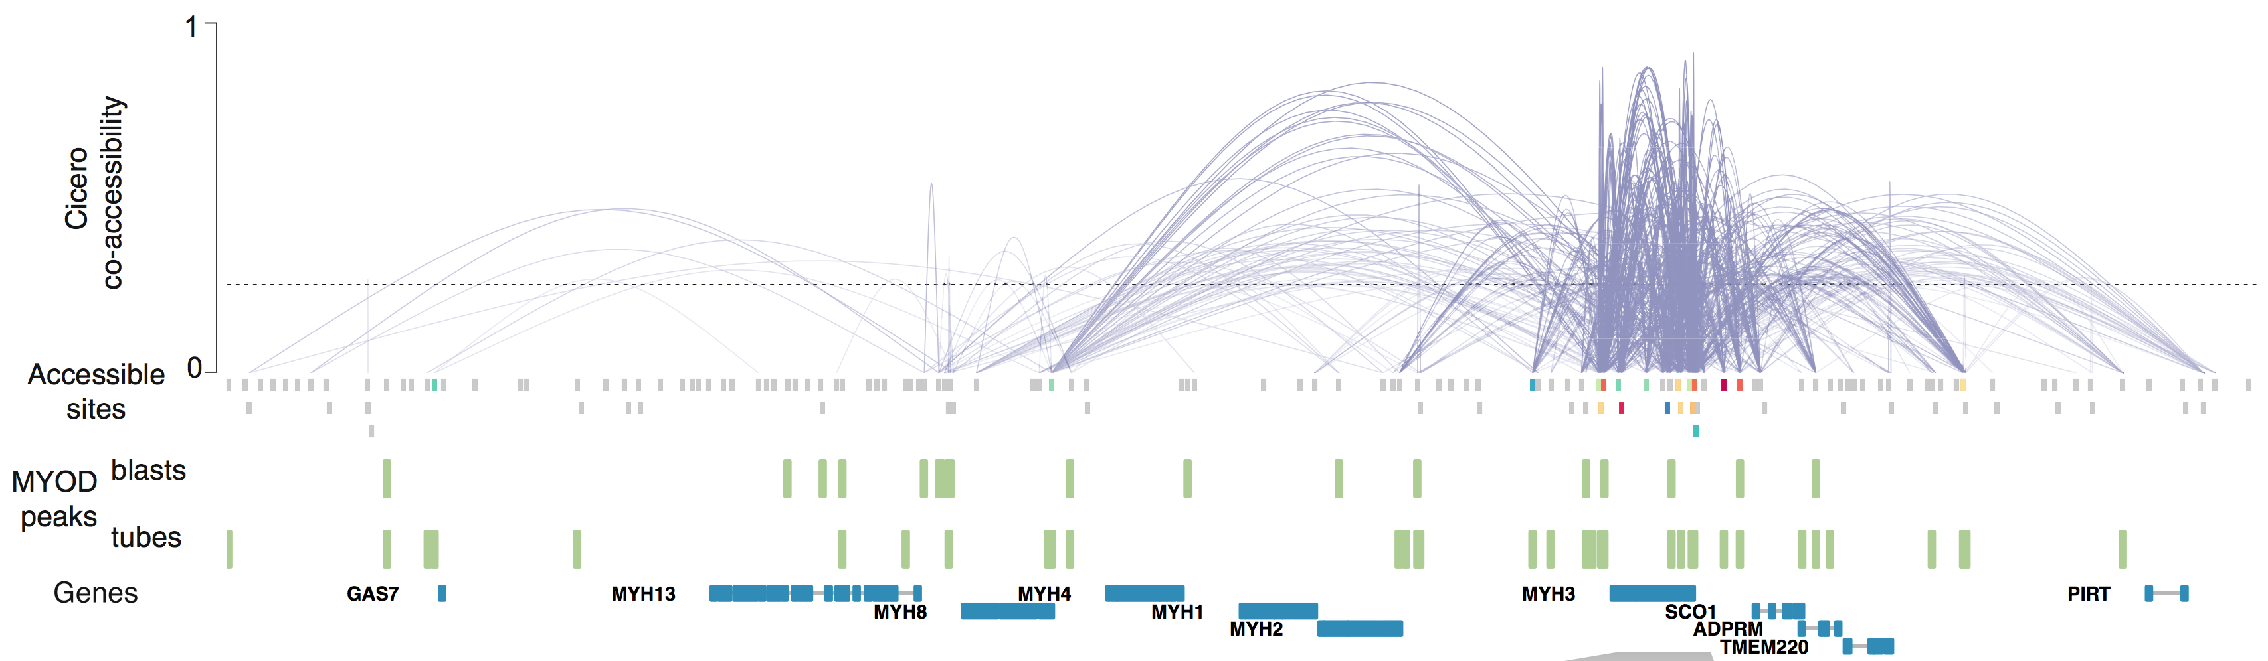
Associating distal regulatory elements to the gene(s) they regulate
Using single-cell ATAC-seq data, Cicero can be used to link distal elements to their regulated genes.
Pliner et al., Mol. Cell 2018

